Slide 1

Machine Learning for Engineers: Linear Regression
Mina Farmanbar
Associate Professor, University of Stavanger
for engineers

Slide 2
Regression
Regression is one of the most useful concepts in statistics because it involves numerical prediction.
It predicts something we do not know, where the answer is a number.
We often collect data on things that are easy to measure and call these the independent variables.
Regression is used to tell us about the things that are often hard to measure, termed the dependent or response variable.

Slide 3

Regression
Imagine you go fishing:
measuring a fish's length is easy, but its weight is harder to determine.
Regression can help predict the fish's weight (dependent variable) based on its length (independent variable).
This would be an example of simple linear regression or using a single independent variable in a regression to predict the dependent variable.

Slide 4
Regression
Regression allows us to make estimations and inference from one variable to another.
When viewing the data as a scatter plot, if a linear pattern is evident, we can describe the relationships between variables by fitting a straight line through the points.
Regression techniques will allow us to draw a line that comes as close as possible to the points.

Slide 5
Linear Regression
A common machine learning approach to modeling systems is called linear regression.
Linear regression is a supervised machine learning approach, which means you've already collected data on many inputs and an output, and your goal is to discover the relationships between them.
Input
Input
Output
Input
Input

Slide 6


Linear Regression
For example, suppose you want to predict the electrical power output from a wind turbine.
Input
Output
Wind speed
Power output

Slide 7
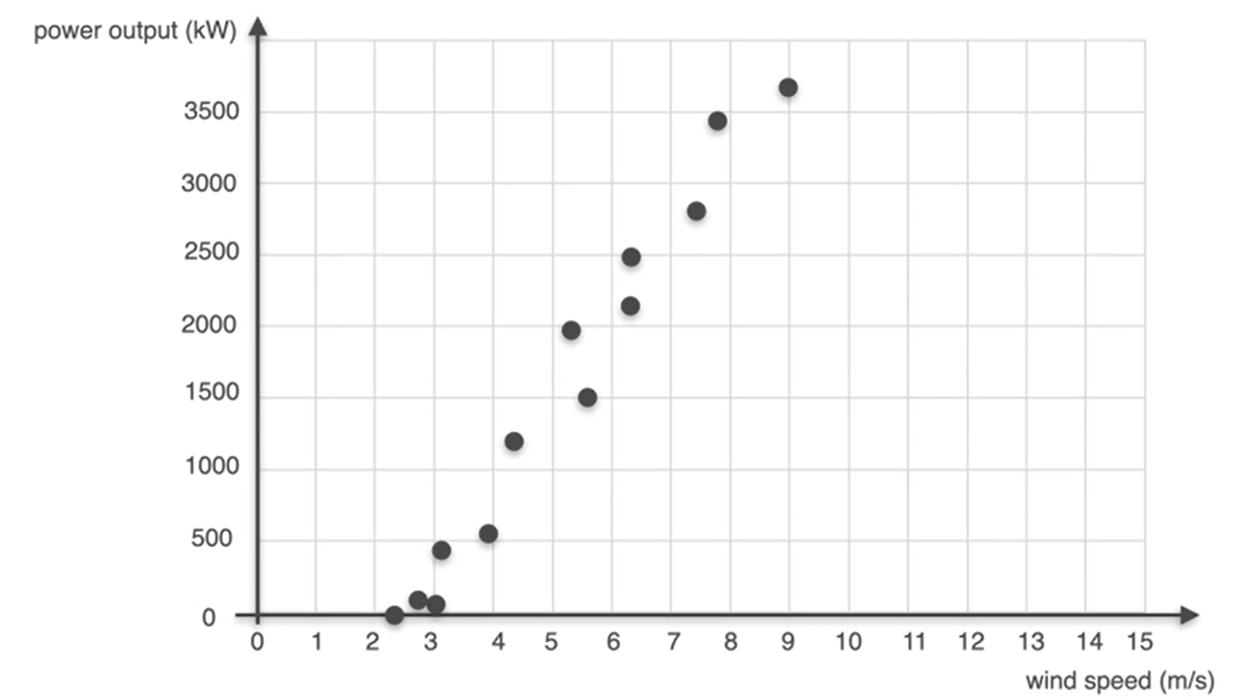
Linear Regression
If you had just one feature, wind speed shown here on the x-axis, then you plot your target of power output on the y-axis. The data points are representing real measurements of wind speed and power output.
Input
Output
Wind speed
Power output

Slide 8
Linear Regression
There's a pattern in the data. The goal of linear regression is to find the line of best fit that represents this pattern, allowing us to predict the power output based on wind speed
Input
Output
Wind speed
Power output

Slide 9

Linear Regression
$Power output= m × Wind speed + b$
𝑦 = 𝑚𝑥 + 𝑏
Input
Output
$$m × Wind speed + b = Power output$$

Slide 10
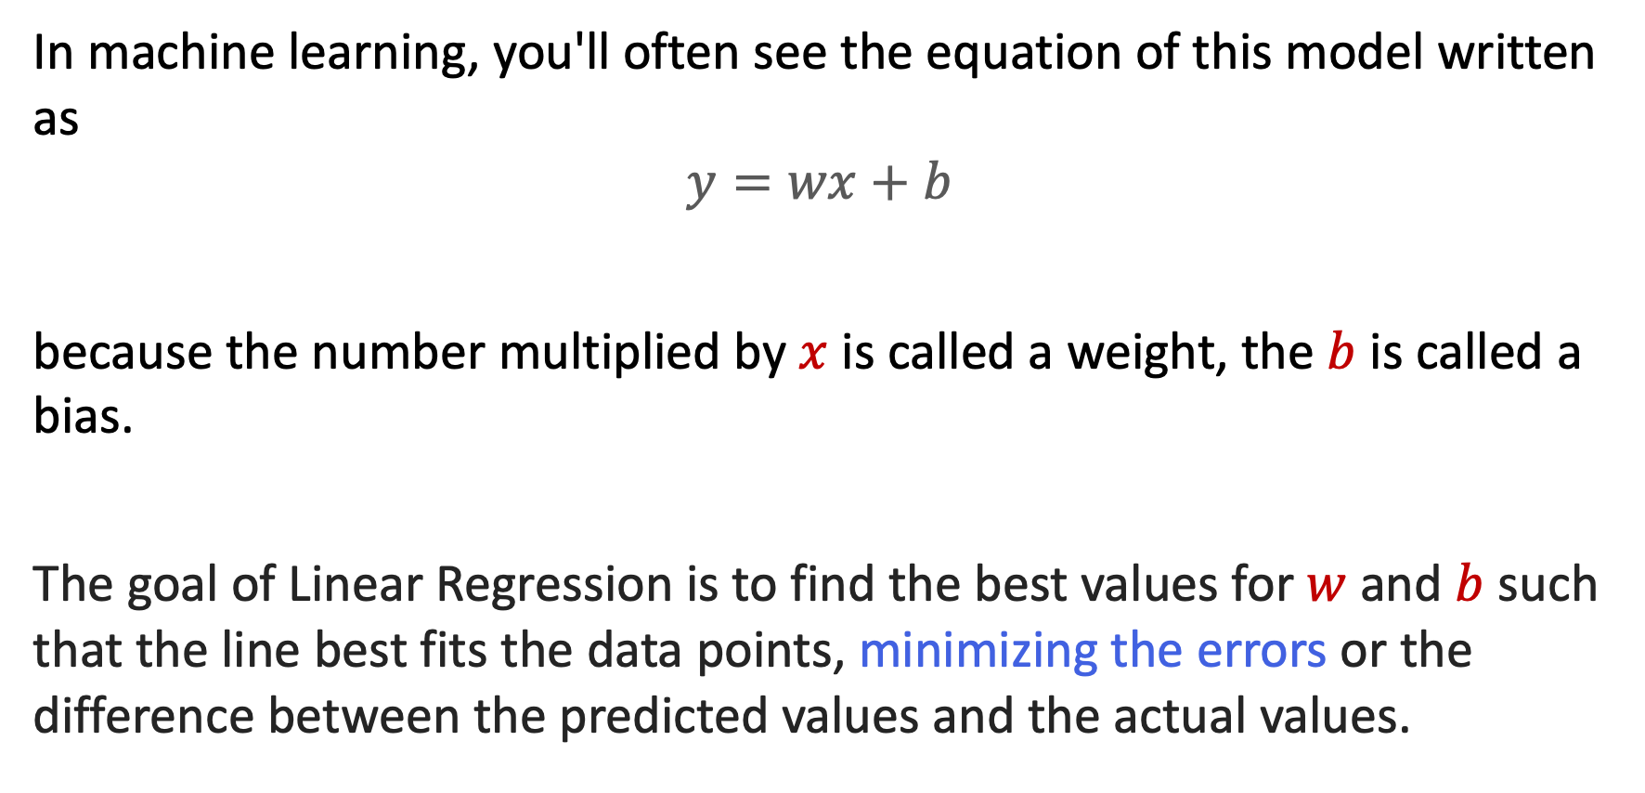
Linear Regression
In machine learning, you'll often see the equation of this model written as
$$y=wx+b$$
because the number multiplied by $x$ is called a weight, the $b$ is called a bias.
The goal of Linear Regression is to find the best values for$w$ and $b$ such that the line best fits the data points, minimizing the errors or the difference between the predicted values and the actual values.

Slide 11
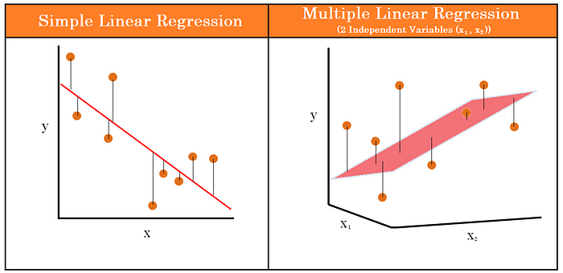
Linear Regression
There are two main types of Linear Regression models: Simple Linear Regression and Multiple Linear Regression.
https://cdn.prod.website-files.com/5e6f9b297ef3941db2593ba1/5f3a434b0444d964f1005ce5_3.1.1.1.1-Linear-Regression.png

Slide 12
Linear Regression
Linear regression with just one feature is easy to visualize, but in many machine learning problems, you'll be considering more features.

Slide 13

Linear Regression
In the case of predicting power output from a wind turbine, you may want to include not only wind speed, but temperature as well.
Input
Input
Output
Wind speed
Temperature
Power output

Slide 14
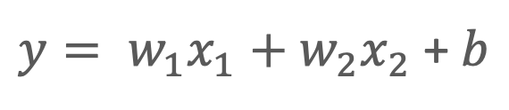
Linear Regression
In order to account for the new input, the equation of your line would need to change.
Input
Input
Output
Wind speed
Temperature
Power output
$y= w_{1}x_{1}+w_{2}x_{2}$ + $b$

Slide 15
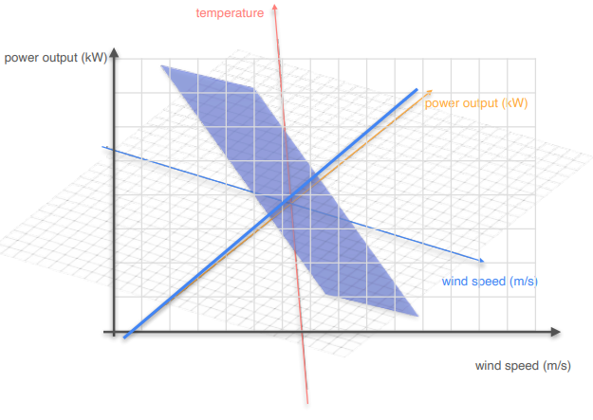
Linear Regression
If you graph this equation, it no longer form a line. Instead, it would be graphed as a plane in three-dimensional space.

Slide 16
Linear Regression
But…
what if you wanted to consider more features like pressure, humidity, or anything else that might affect the performance of the wind turbine?
The idea is exactly the same as with one or two features!!

Slide 17
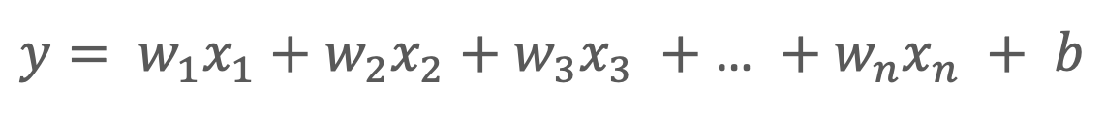

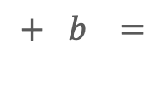



Linear Regression
$$w_{1}$$
Feature 1
$+$ $w_{2}$
Feature 2
$+$ $w_{3}$
Feature 3
$+$ $w_{4}$
Feature 4
$+$ $b =$
Output
$y= w_{1}x_{1}+w_{2}x_{2}$ $+{ w}_{3}x_{3} +$ … $+{ w}_{n}x_{n} +$ $b$

Slide 18
Linear Regression
$y^{\left(1\right)}= w_{1}x_{1}^{\left(1\right)}+w_{2}x_{2}^{\left(1\right)}+{ w}_{3}x_{3}^{\left(1\right)}+$ … $+{ w}_{n}x_{n}^{\left(1\right)}$ $+$ $b$
$y^{\left(2\right)}= w_{1}x_{1}^{\left(2\right)}+w_{2}x_{2}^{\left(2\right)}+{ w}_{3}x_{3}^{\left(2\right)}+$ … $+{ w}_{n}x_{n}^{\left(2\right)}$ $+$ $b$
$y^{\left(3\right)}= w_{1}x_{1}^{\left(3\right)}+w_{2}x_{2}^{\left(3\right)}+{ w}_{3}x_{3}^{\left(3\right)}+$ … $+{ w}_{n}x_{n}^{\left(3\right)}$ $+$ $b$
.
.
.
$y^{\left(m\right)}= w_{1}x_{1}^{\left(m\right)}+w_{2}x_{2}^{\left(m\right)}+{ w}_{3}x_{3}^{\left(m\right)}+$ … $+{ w}_{n}x_{n}^{\left(m\right)}$ $+$ $b$
System of Linear Equations

Slide 19
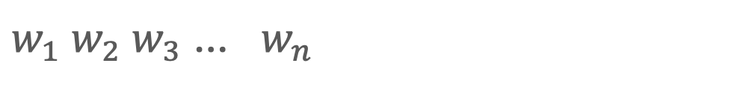
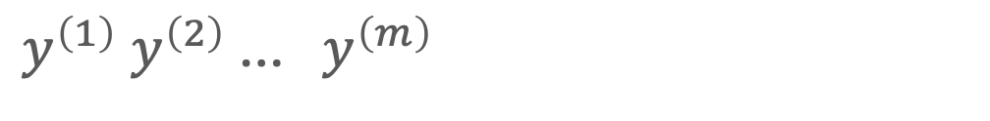
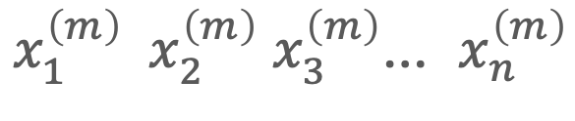
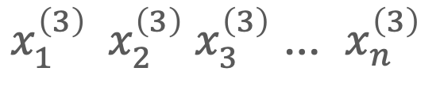

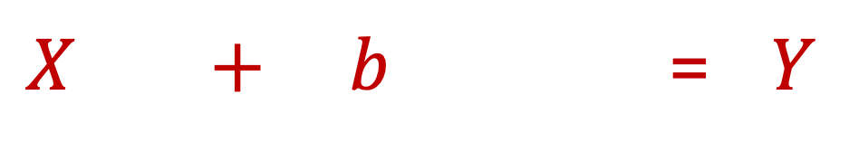
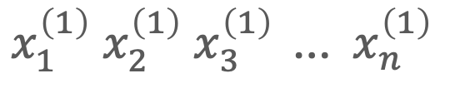

Linear Regression
$$w .$$
$X + b$ = $Y$
$x_{1}^{\left(1\right)} x_{2}^{\left(1\right)} x_{3}^{\left(1\right)} {\text{…} x}_{n}^{\left(1\right)}$
$w_{1} w_{2}{ w}_{3}$ … ${ w}_{n}$
$y^{\left(1\right)} y^{\left(2\right)}$…${ y}^{\left(m\right)}$
$x_{1}^{\left(2\right)} x_{2}^{\left(2\right)} x_{3}^{\left(2\right)}$ … $x_{n}^{\left(2\right)}$
Vector
Vector
$x_{1}^{\left(3\right)} x_{2}^{\left(3\right)} x_{3}^{\left(3\right)}$ … $x_{n}^{\left(3\right)}$
.
.
.
$x_{1}^{\left(m\right)} x_{2}^{\left(m\right)} x_{3}^{\left(m\right)}$… $x_{n}^{\left(m\right)}$
Matrix

Slide 20
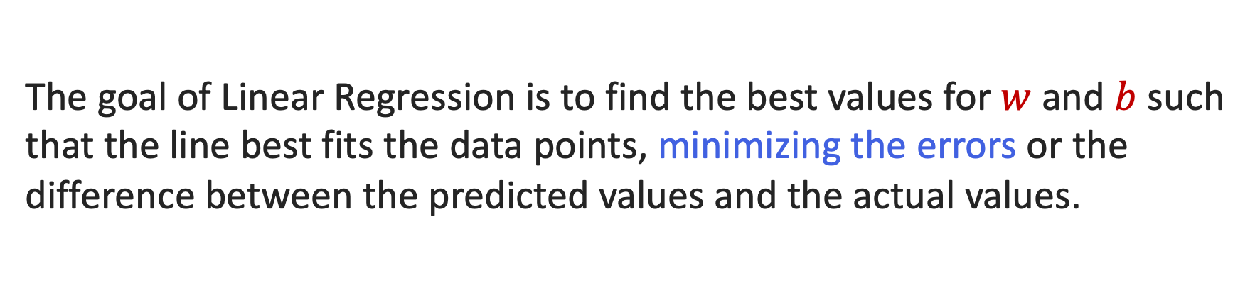
Linear Regression
The goal of Linear Regression is to find the best values for$w$ and $b$ such that the line best fits the data points, minimizing the errors or the difference between the predicted values and the actual values.

Slide 21
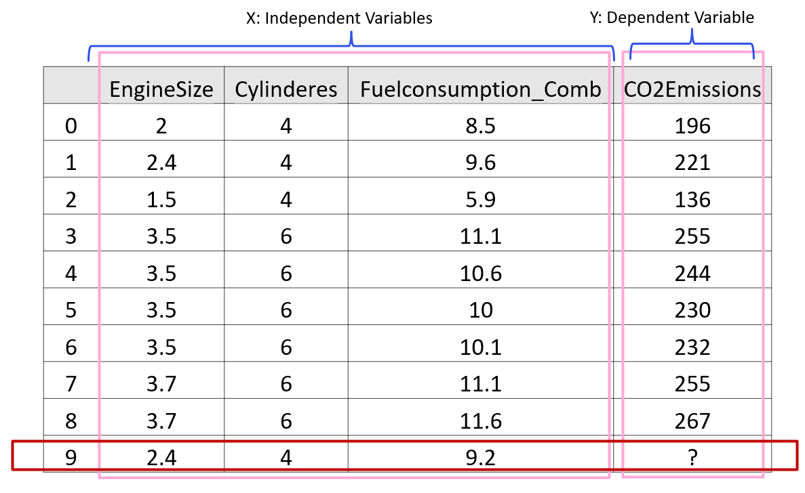
Linear Regression

Slide 22
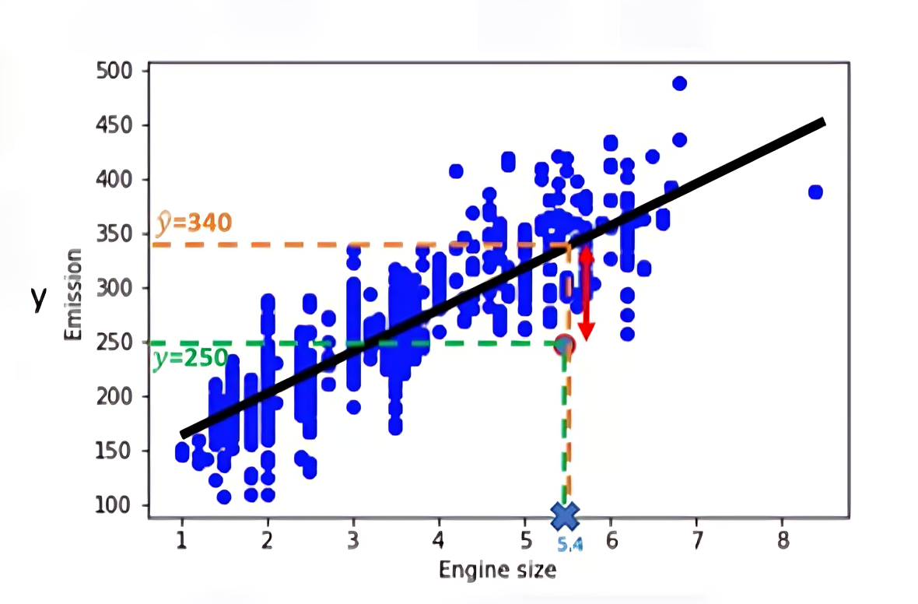
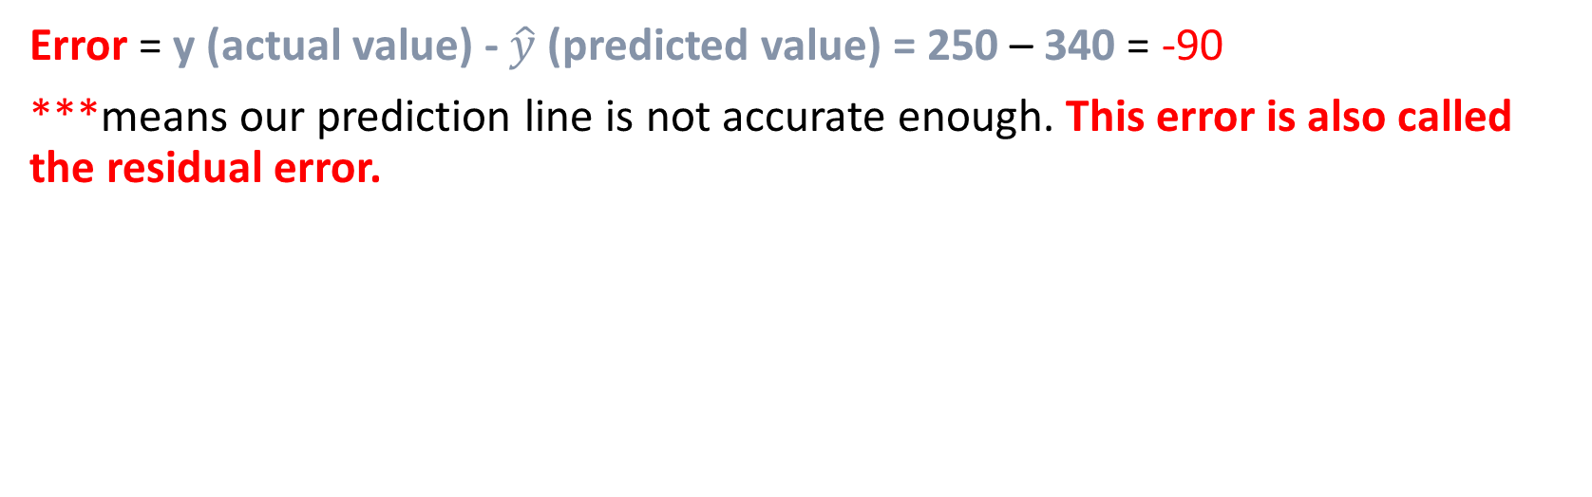
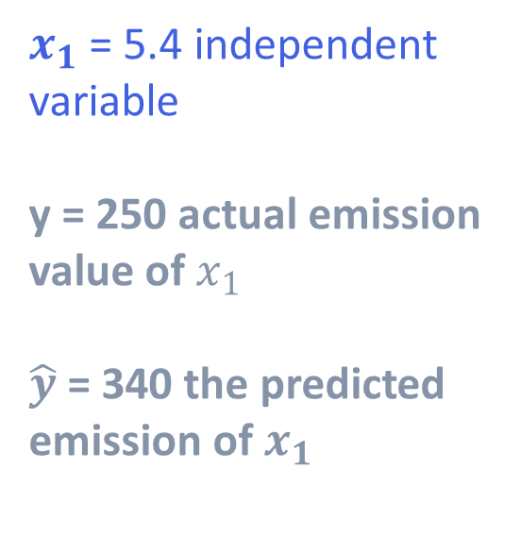
Linear Regression
$x_{1}$ = 5.4 independent variable
y = 250 actual emission value of $x_{1}$
$\hat{y}$ = 340 the predicted emission of $x_{1}$
https://higherlogicdownload.s3.amazonaws.com/IMWUC/UploadedImages/92757287-d116-4157-b004-c2a0aba1b048/Fit-Line.png
Error = y (actual value) - $\hat{y}$ (predicted value) = 250 – 340 = -90
***means our prediction line is not accurate enough. This error is also called the residual error.

Slide 23
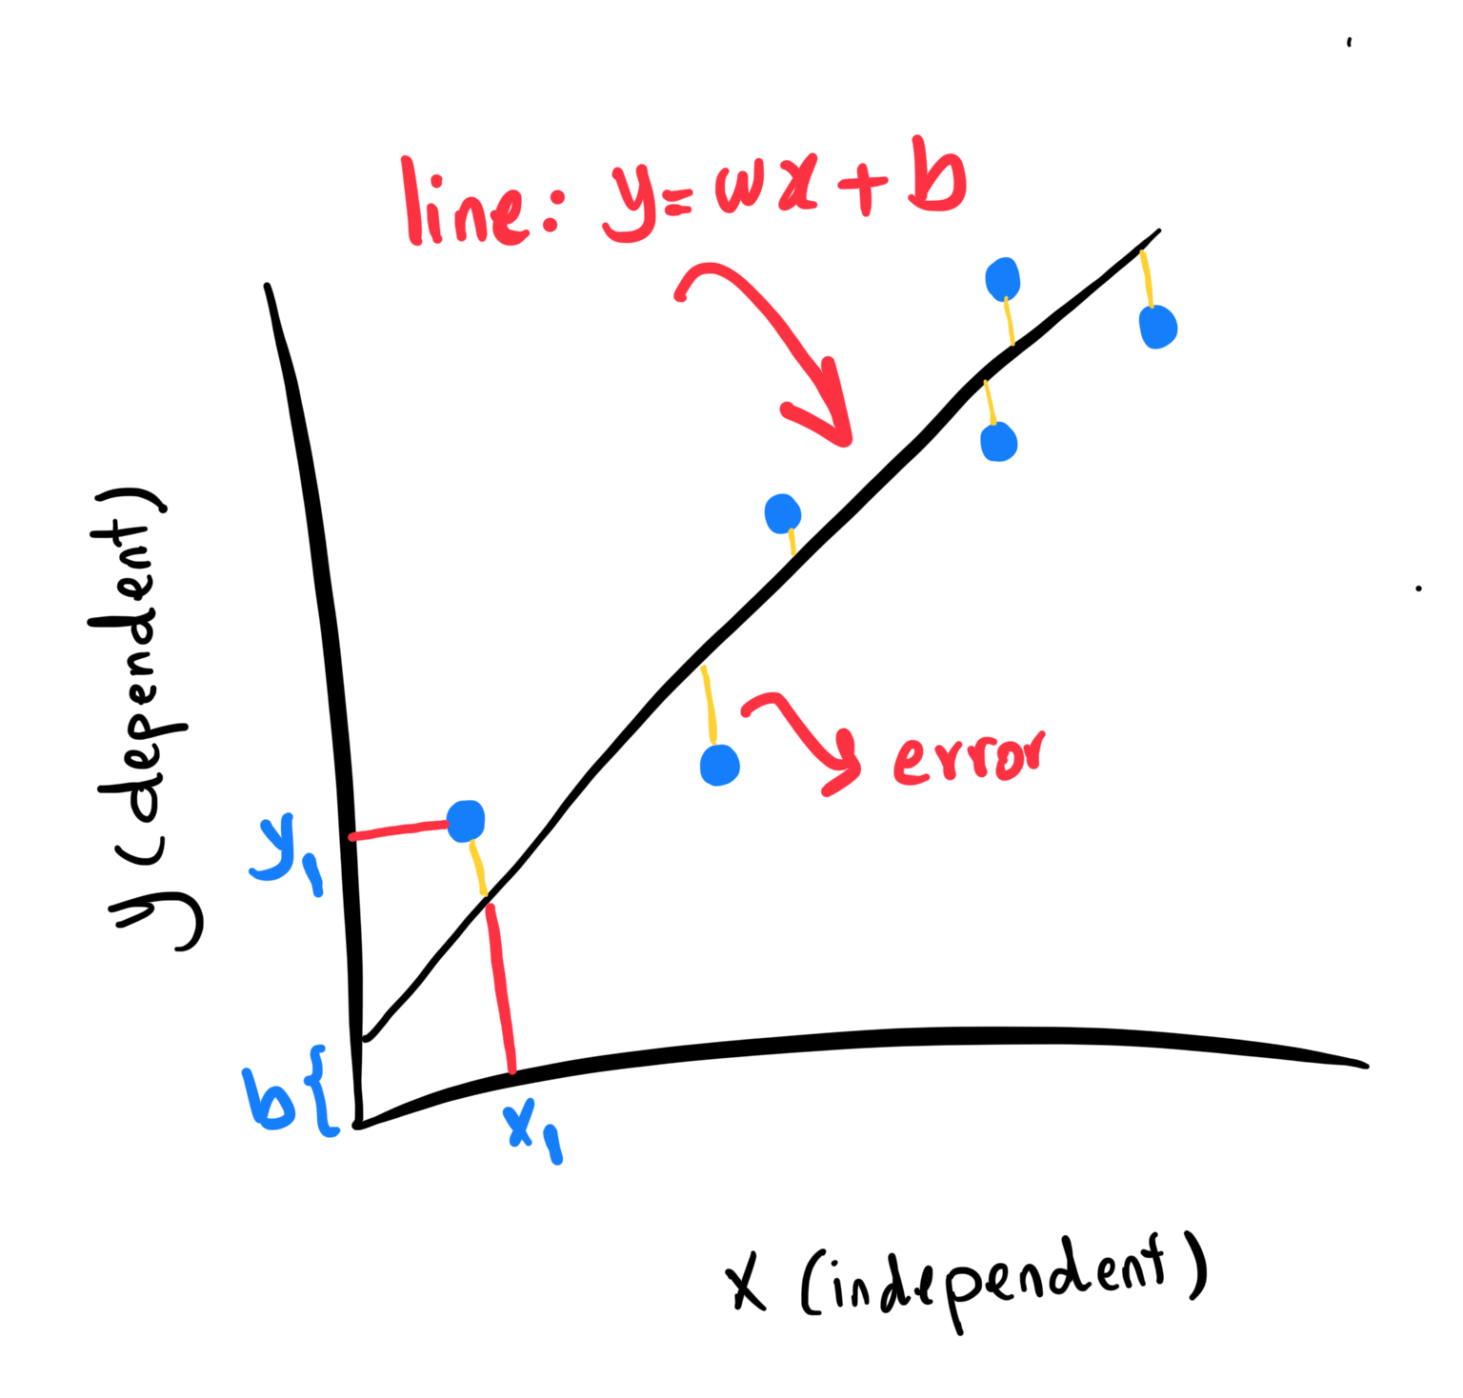
Linear Regression
To find the best-fitting line in a linear regression model, we use a process called “ordinary least squares (OLS) regression”.
This process involves calculating the sum of the squared differences between the predicted values and the actual values for each data point, and then finding the line that minimizes this sum of squared errors.

Slide 24
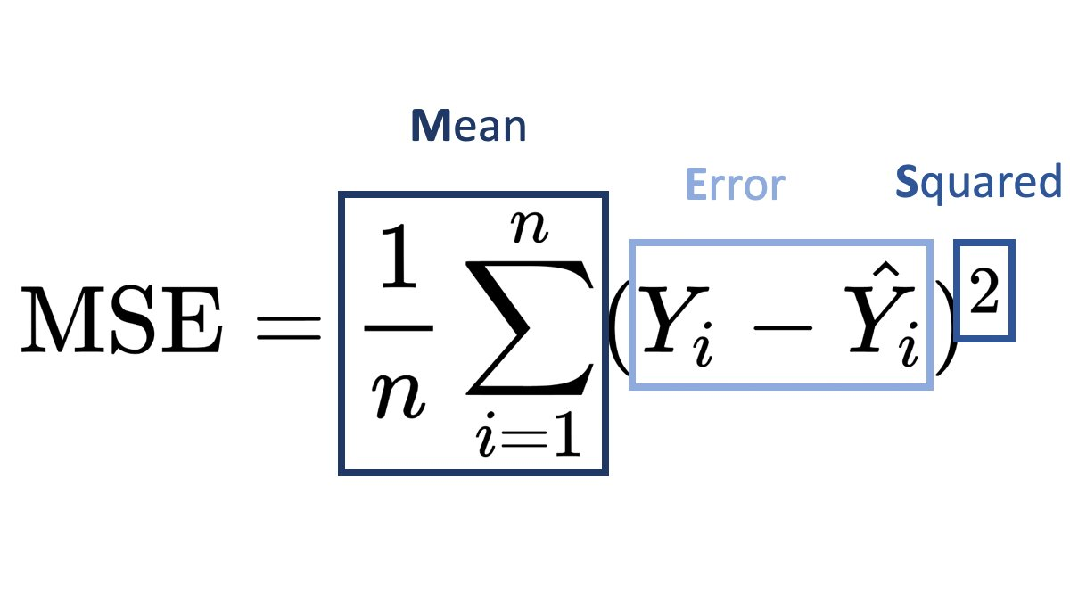
Mean Squared Error (MSE)
Mean Squared Error (MSE)
Our objective is to find a line where the mean of all these errors is minimized.
In other words, the mean error of the prediction using the fit line should be minimized.

Slide 25
Mean Squared Error (MSE)
*** to minimize it, we should find the best parameters 𝒘 and 𝒃.
Now the question is how to find 𝒘 and 𝒃 in such a way that it minimizes this error?
How can we find such a perfect line?
Or another way, how should we find the best parameters for our line?
Should we move the line a lot randomly and calculate the MSE value every time and choose the minimum one?

Slide 26
Mean Squared Error (MSE)
We have two options here:
we can use a mathematic approach, or
we can use an optimization approach.

Slide 27
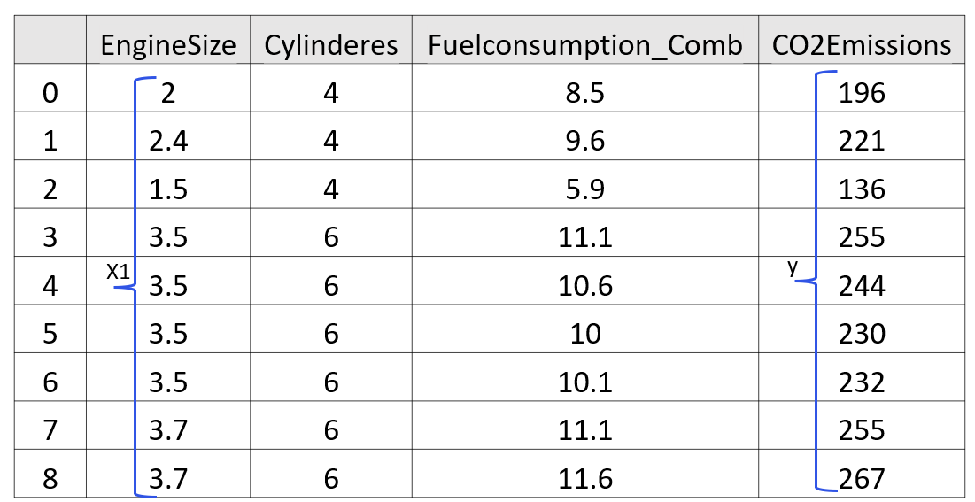
Mean Squared Error (MSE)
we can estimate them directly from our data.
It requires that we calculate the mean of the independent and dependent or target column from the dataset separately.

Slide 28
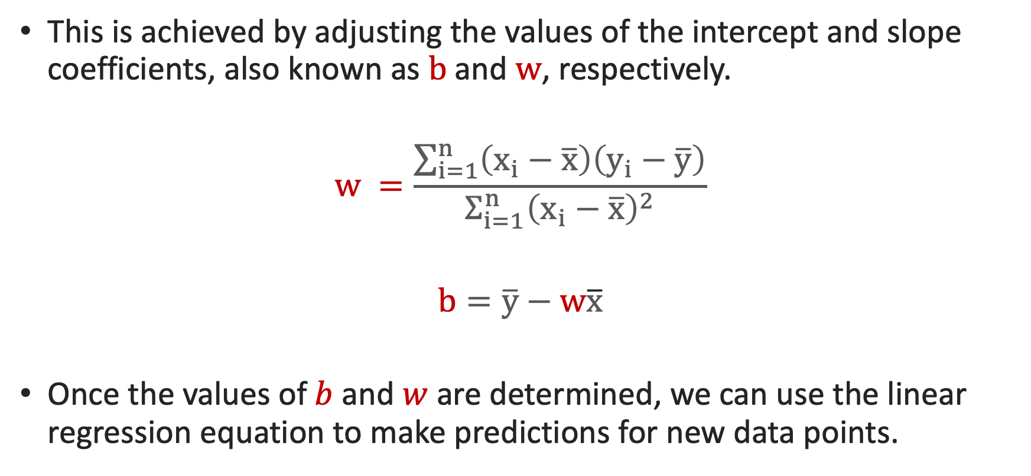
Linear Regression
This is achieved by adjusting the values of the intercept and slope coefficients, also known as $b$and $w$, respectively.
$$w =\frac{\sum_{i=1}^{n}{\left(x_{i}−\overline{x}\right)\left(y_{\dot{i}}−\overline{y}\right)}}{Σ_{ⅈ=1}^{n}{\left(x_{i}−\overline{x}\right)}^{2}}$$
$$b=\overline{y}−w\overline{x}$$
Once the values of$b$ and$w$ are determined, we can use the linear regression equation to make predictions for new data points.

Slide 29
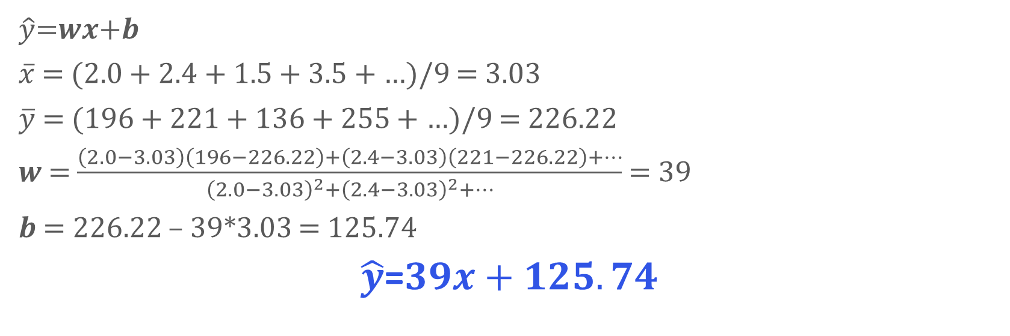
Mean Squared Error (MSE)
$\hat{y}$=𝒘𝒙+𝒃
$\overline{x}$ = (2.0 + 2.4 + 1.5 + 3.5 + …)/9 = 3.03
$\overline{y}$ = (196 + 221 + 136 + 255 + …)/9 = 226.22
𝒘 = $\frac{\left(2.0−3.03\right)\left(196−226.22\right)+\left(2.4−3.03\right)\left(221−226.22\right)+…}{{\left(2.0−3.03\right)}^{2}+{\left(2.4−3.03\right)}^{2}+…}$ = 39
𝒃 = 226.22 – 39*3.03 = 125.74
$\hat{y}$=$39x+125.74$

Slide 30
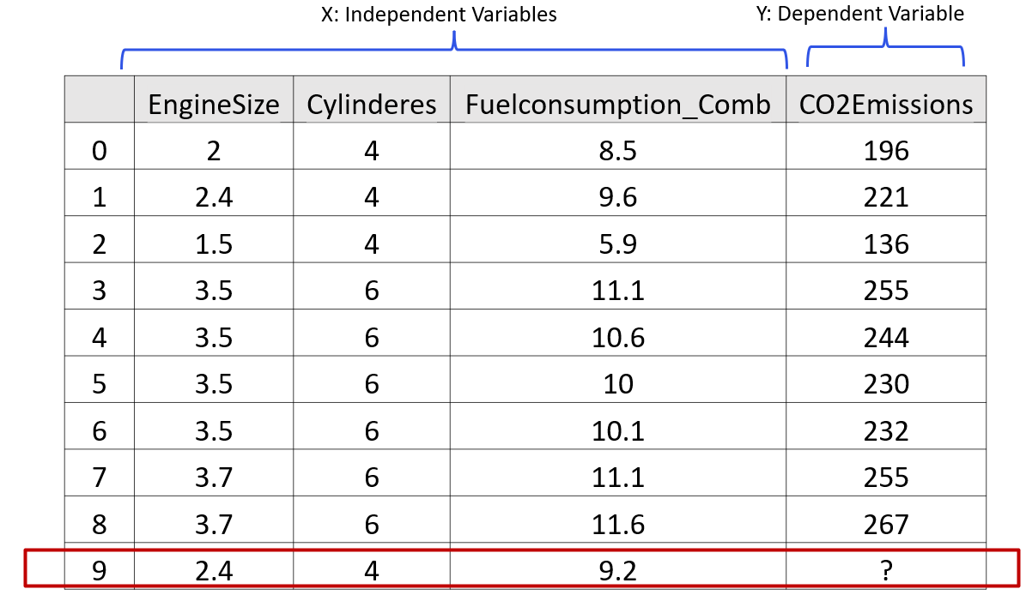
Mean Squared Error (MSE)
Co2Emissions = w* EngineSize + b
= 39* EngineSize + 125.74
= 39* 2.4 + 125.74
= 218.6

Slide 31
Summary
In linear regression, you're solving the system by trial and error, meaning iteratively and approximately, to find the best-fit linear solution.
it is the most basic regression to use.
It also doesn't require tuning of parameters.
Linear regression is also easy to understand, and highly interpretable.

Slide 32
Thank you!
Mina Farmanbar
mina.farmanbar@uis.no

